Slide 1
End of the Semester Project
Jericho McGowan

Slide 2

Movie and TV Show Tracker
Why?
Personal Organization of Movies and TV Shows.
I wish to convert this into an application that can be used on mobile devices over winter break
Original Plan:
Design a Website that could be used to track the watch status of Movies and TV Shows per user
The information on the TV Show/Movie would be obtained via a search bar which has a database of movies and TV shows that it finds a match on.
The user can also add custom Movie or TV Show entries to the database

Slide 3




Design:
FastAPI
&
Blazor

Slide 4

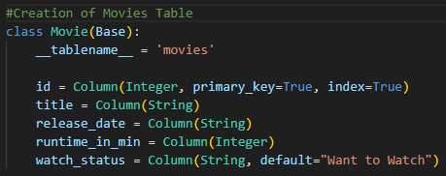
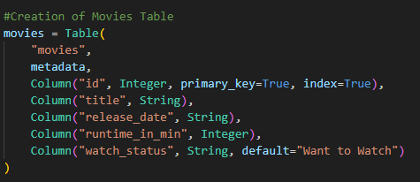
Backend Feature – Table Import
Table Import from SQLAlchemy allows for ease when creating tables
Looks cleaner

Slide 5

Backend Feature – Reload Upon Save
You can force uvicorn to reload upon save to allow for easier developer changes

Slide 6


Blazor Quirk
Base address declaration does not carry from main program.cs to razor components.

Slide 7
Strategy
Create the structure of a FastAPI App
Implement SQLAlchemy functions into API
Connect FastAPI to a database
Create a Default Blazor Application
Implement components and models to test CRUD Operations
Design Movie and TV Show List Pages
Finish project…

Slide 8
Challenges
Interactions between API and Blazor
CRUD Operations:
“Unprocessable entities”
Edit Form

Slide 9
PROJECT DEMO

Slide 10
Future of Project
Complete Search Functionality
Connect an external live database of Movies & TV Shows
Cleanup Website Design to be fluid
Associate each unique list to a user via a login ID
Include a main page that shows user’s recent additions their lists

